Slide 1

StarSchema Database Project
Learn to use the Data Modification Language: INSERT, UPDATE, DELETE, TRUNCATE, MERGE
Jasmine kim

Slide 2
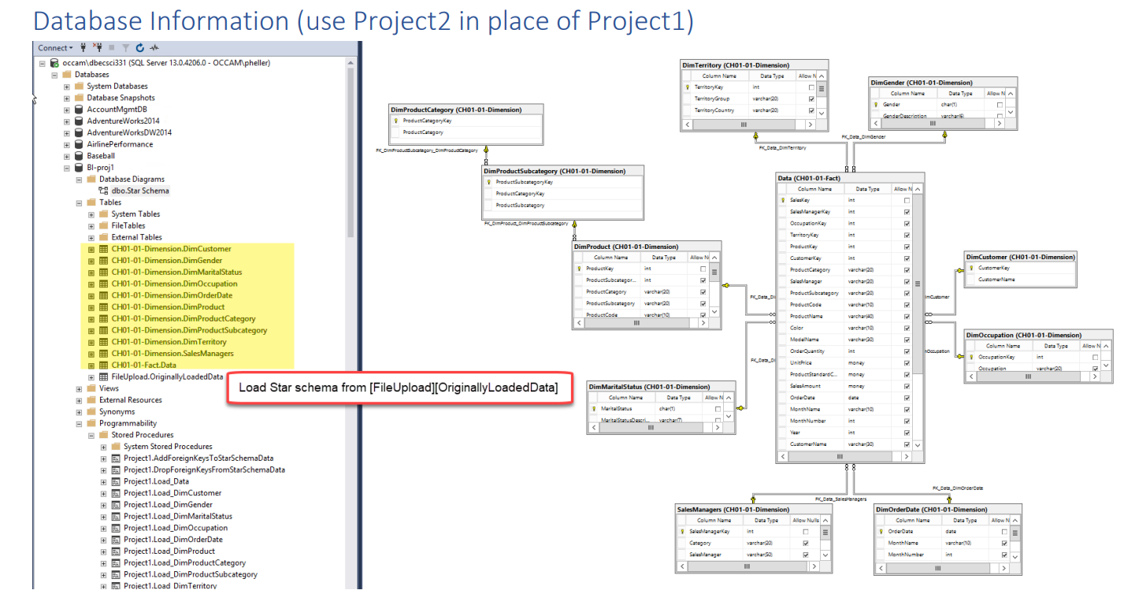

Slide 3
Steps
Add 3 additional columns
Replace IDENTITY property with SEQUENCE object
Truncate
Reload
Restore foreign-key relationships
Create Workflow table and compute duration
Create 2 additional tables to show gradparent-paraent-child relationship
JDBC

Slide 4
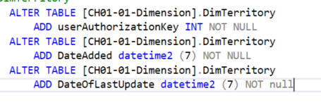
Adding 3 additional columns

Slide 5
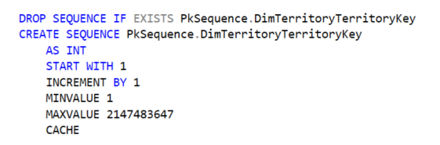
Replace IDENTITY property with SEQUENCE object

Slide 6
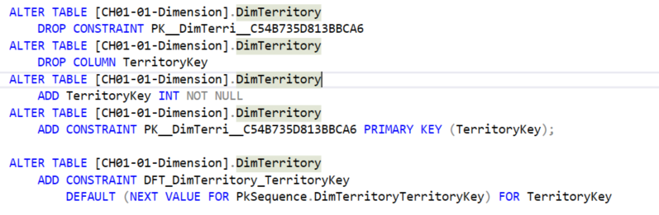
Replace IDENTITY property with SEQUENCE object

Slide 7
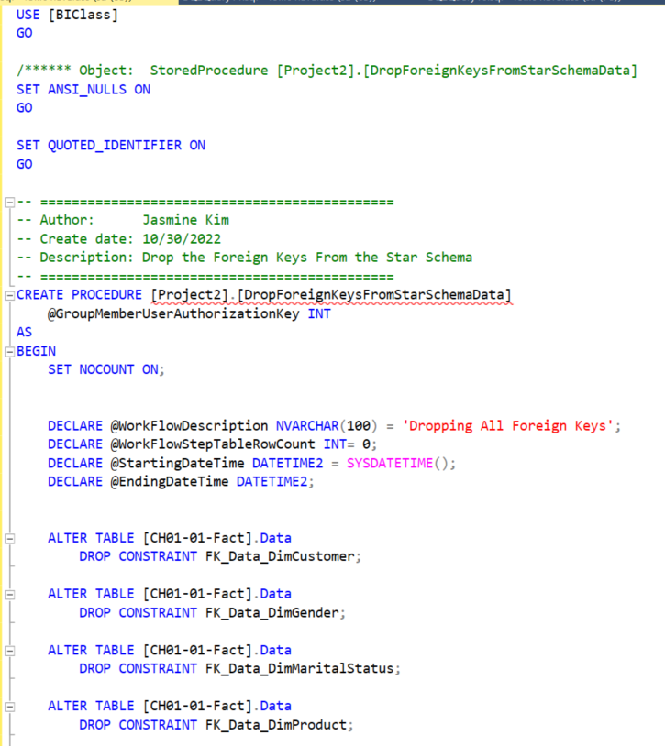
TRUNCATE: Drop foreign keys

Slide 8
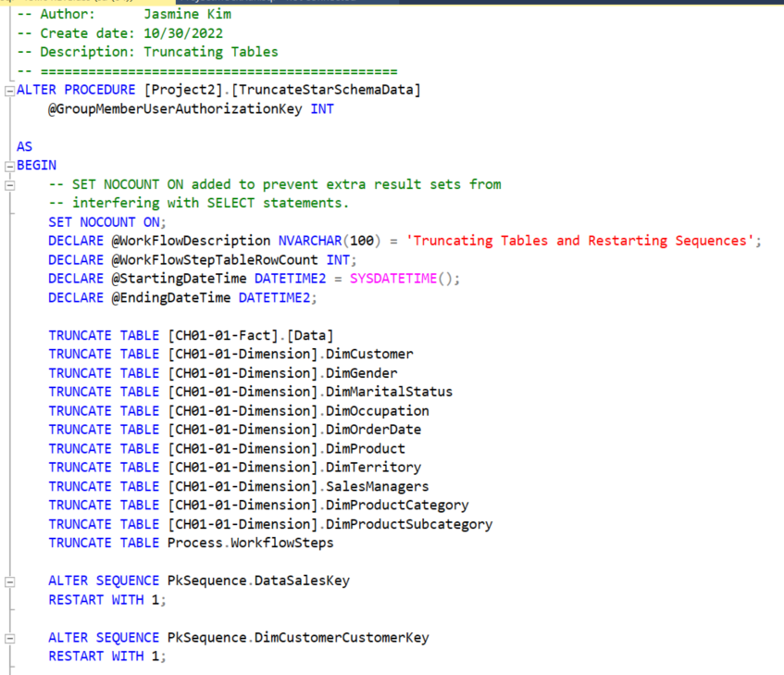
TRUNCATE

Slide 9
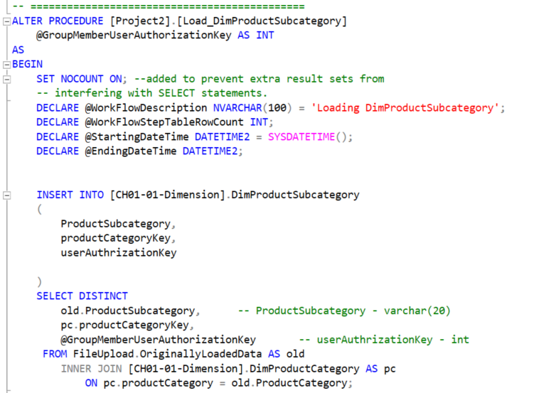
Load data

Slide 10
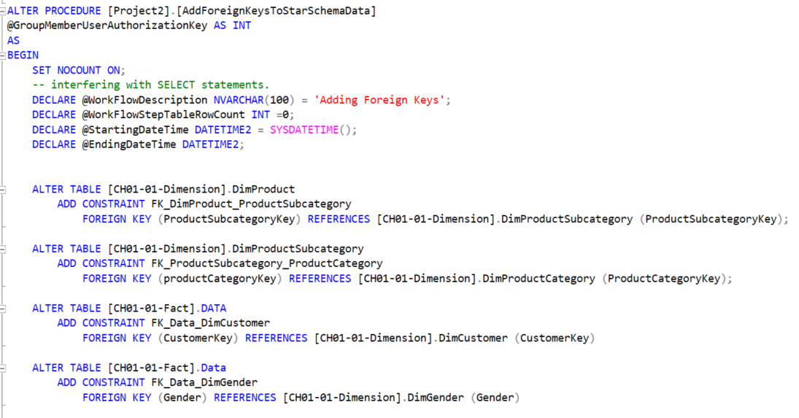
Restore Foreign Keys

Slide 11
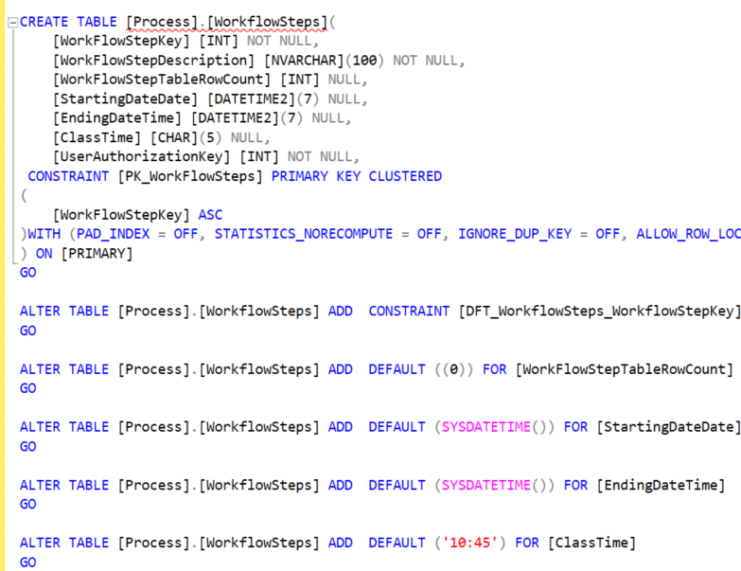
Workflow Table

Slide 12
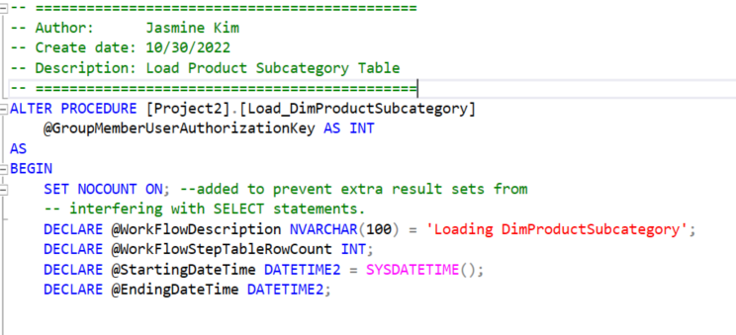
Embed Workflow into Every Stored Procedure

Slide 13
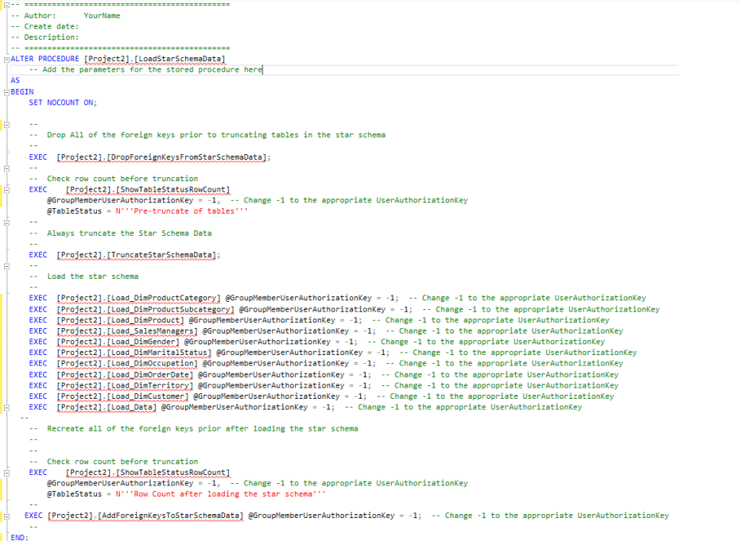
Load Star Schema Stored Procedure

Slide 15
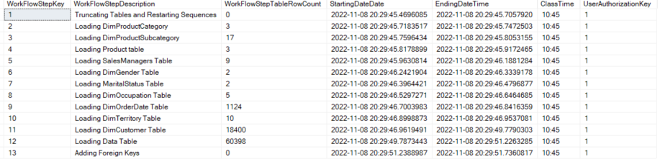
Workflow Steps Table

Slide 16
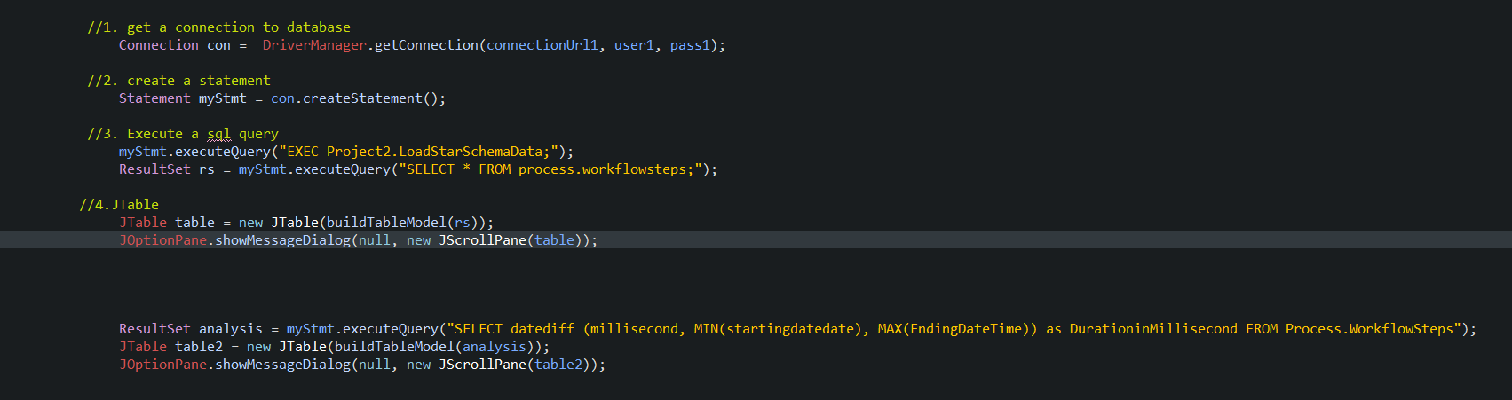
JDBC

Slide 17
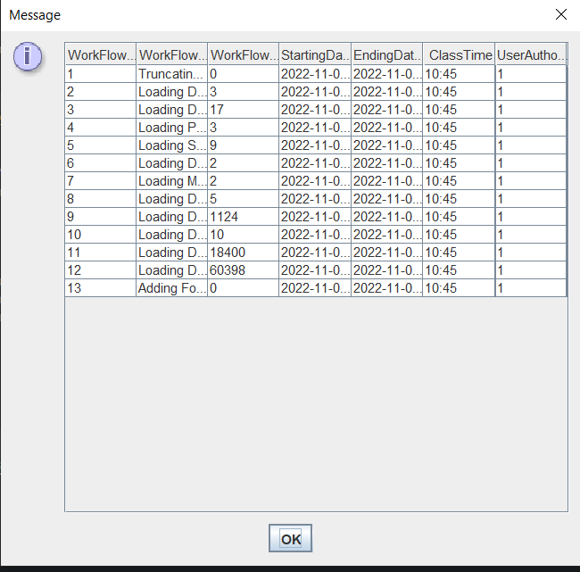
JTable

Slide 18
Calculate Duration

